Slide 1
Managing Basic Storage and Logical Volumes
• Adding Partitions, File Systems, and Persistent Mounts
• Managing Swap Space
• Creating Logical Volumes
• Extended Logical Volumes

Slide 2
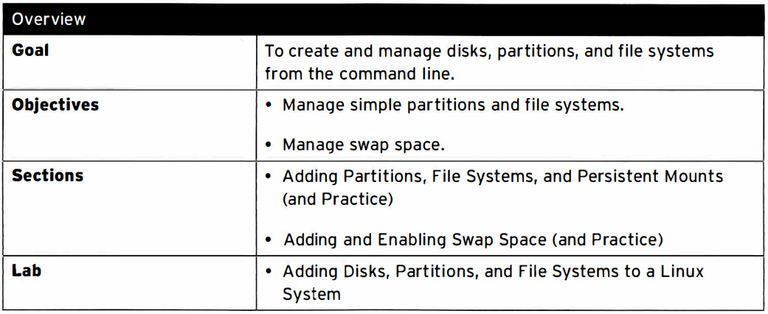
Managing storage

Slide 3
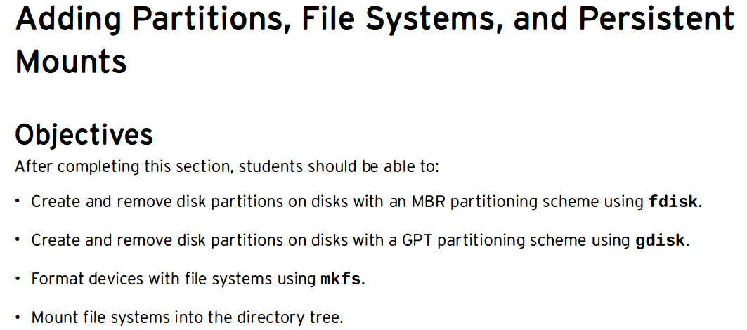

Slide 4
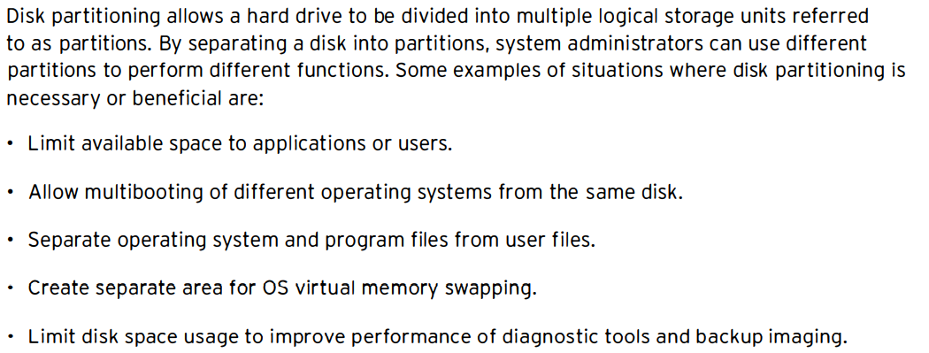
Disk partitioning

Slide 5
MBR partitioning scheme
Since 1982, the Master Boot Record (MBR) partitioning scheme has dictated how disks should be partitioned on systems running BIOS firmware.
This scheme supports a maximum of four primary partitions.
On Linux systems, with the use of extended and logical partitions, administrator can create a maximum of 15 partitions.
Since partition size data are stored as 32-bit values, disks partitioned with the MBR scheme have a maximum disk and partition size limit of 2 TiB.

Slide 6
GUID Partition Table (GPT) for disk partitioning
For systems running Unified Extensible Firmware Interface (UEFI) firmware, GPT is the standard for laying out partition tables on physical hard disks.
GPT is part of the UEFI standard and addresses many of the limitations imposed by the old MBR-based scheme.
Per UEFI specifications, GPT defaults to supporting up to 128 partitions.
Unlike MBR, which uses 32 bits for storing logical block addresses and size information, GPT allocates 64 bits for logical block addresses.
This allows GPT to accommodate partitions and disks of up to 8 zebibyte (ZiB), or 8 billion tebi bytes.

Slide 7
Storage Devices
A physical component that can record data and hold it persistently.
Types:
Hard disk drive (HDD)
Solid-state drive (SSD)
USB thumb drive
External storage drive

Slide 8
File systems
A data structure that is used by an OS to store, retrieve, organize and manage files and directories on storage devices.
Types:
FAT, ext2, ext3, etx4, XFS, NTFS

Slide 9
Partitions
Dividing the large drive into smaller manageable chunks, leading to better organization of information.
A partition must be formatted and assigned a file system before data can be stored on it.

Slide 10
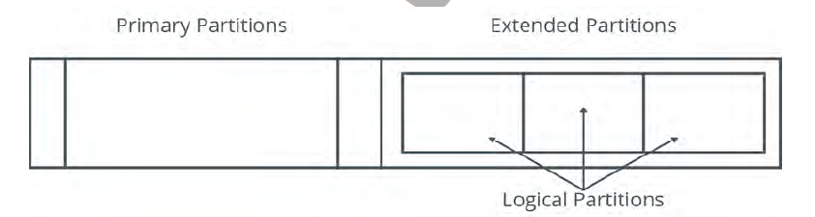
Types of Partitions
Three types of partitions:
Primary, extended and logical

Slide 11
Types
Primary Partition: A partition that can contain one file system or logical drive. A user can create only four primary partitions
Extended Partition: A partition that can contain several file systems. There can be only one extended partition which can be further sub-divided into logical partitions.
Logical Partitions: It is created within an extended partition. There is no restriction of logical partitions but advisable is 12 logical partitions per drive.

Slide 12
Swap Space
It is used when system runs out of physical memory.
Linux keeps some of the unused files from RAM to the swap space to free up memory.
Usually swap space should be double the RAM capacity.

Slide 13
The ‘fdisk’ command
This command is used to create, modify or delete partitions on storage drive.
Syntax:
# fdisk [options] {device name}
# fdisk /dev/sda (sda→ storage device)

Slide 14
fdisk menu options
n: Create a new partition.
d: Deletes a partition.
p: Prints/Lists the existing partitions.
w: For saving or writing the changes.
q: Cancel the changes made.

Slide 15
The ‘partprobe’ command
It is used to update the newly modified partition table.
The command first checks the partition table, if there is any changes, it automatically updates the kernel with the changes.

Slide 16
The ‘mkfs’ command
To build Linux file system on a device.
Synatx:
mkfs.{file system type} {device name}
Example:
mkfs.ext4 /dev/sda1

Slide 17
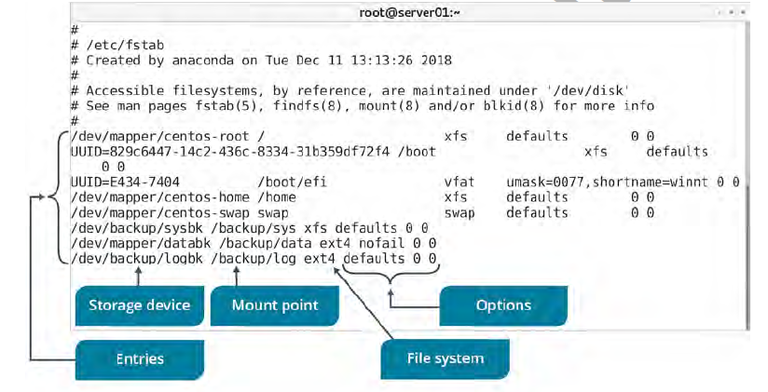
The ‘fstab’ file
A configuration file that stores information about storage devices and partitions and where and how the partitions should be mounted.
The fstab file is located in /etc directory

Slide 18
Mount Points
A mount point is an access point to an information stored on device.
The mount command: Loads a file system to a specified directory so that it can accessible to the user.
Syntax:
mount {device name} {mount point}

Slide 19
To check disk used for a directory
du –h <dir name>

Slide 20
The ‘umount’ command
After using the mounted file system, it can be disconnected from the directory by unmounting the file system using umount command.
Synatx:
umount {mounting point}

Slide 21
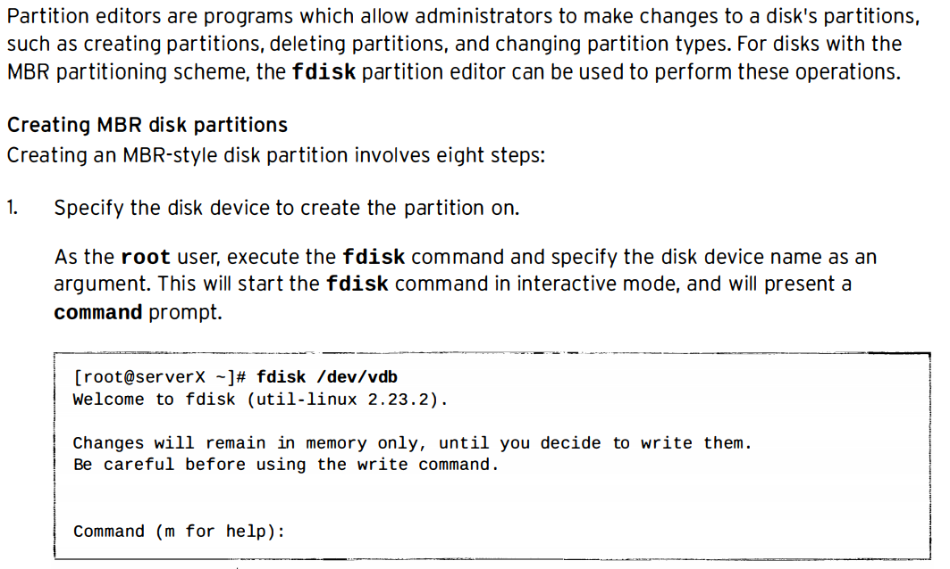
Managing MBR partitions with fdisk

Slide 22
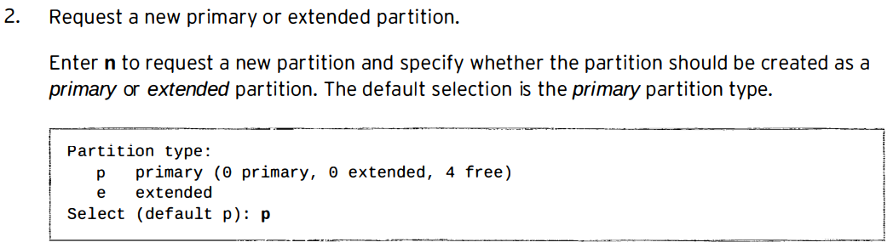
Managing MBR partitions with fdisk

Slide 23
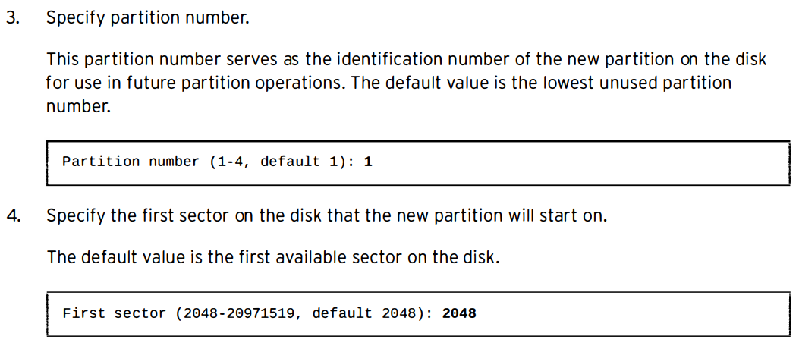
Managing M BR partitions with fdisk

Slide 24
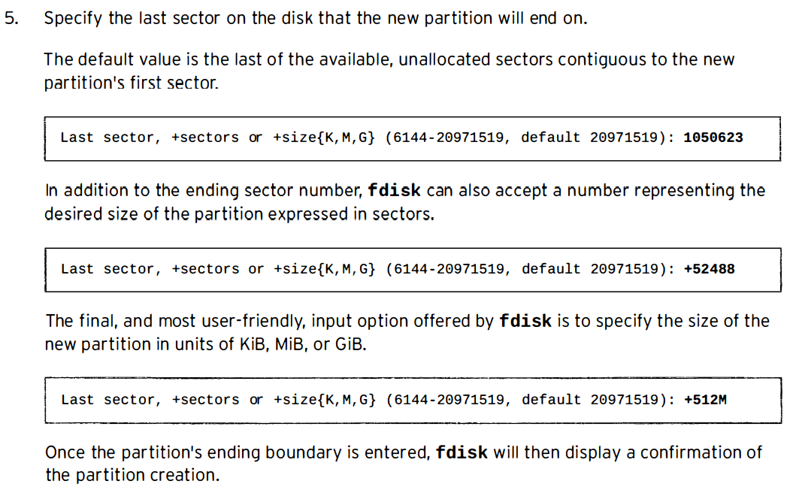
Managing MBR partitions with fdisk

Slide 25
6. Define partition type
If the newly created partition should have a type other than Linux, enter the ‘t’ command to change a partition's type.
Enter the hex code for the new partition type. If needed, a table of the hex codes for all partition types can be displayed with the “L” command.
Setting the partition type correctly is crucial, since some tools rely on it to function properly.

Slide 26
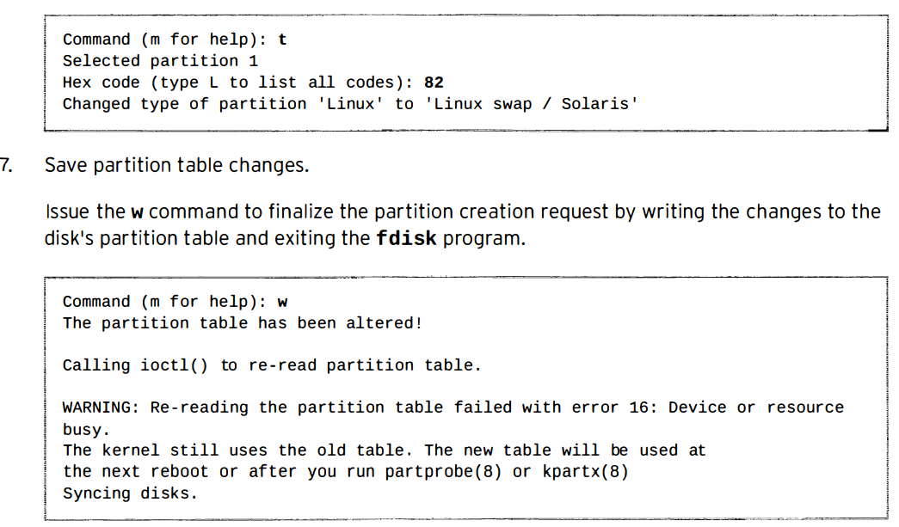

Slide 27
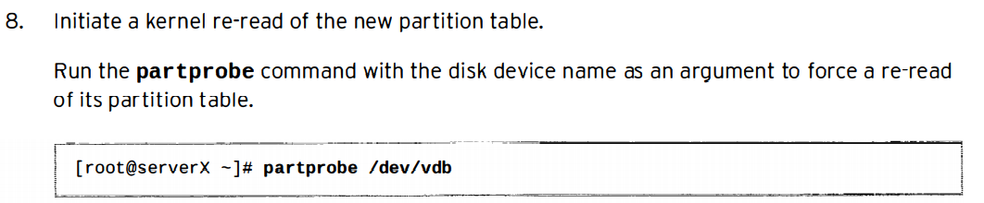

Slide 28
Advantages
To install multiple OS on same HDD.
To enhance the data security.
Better HDD space utilization.

